Slide 1


Robust Monotonic Optimization Framework for Multicell MISO Systems
Emil Björnson¹, Gan Zheng², Mats Bengtsson¹, Björn Ottersten^{1,2}
¹ Signal Processing Lab., ACCESS Linnaeus Centre, KTH Royal Institute of Technology, Sweden
² Interdisciplinary Centre for Security, Reliability and Trust (SnT), University of Luxembourg, Luxembourg
Published in IEEE Transactions on Signal Processing, vol. 60, no. 5, pp. 2508-2523, May 2012

Slide 2
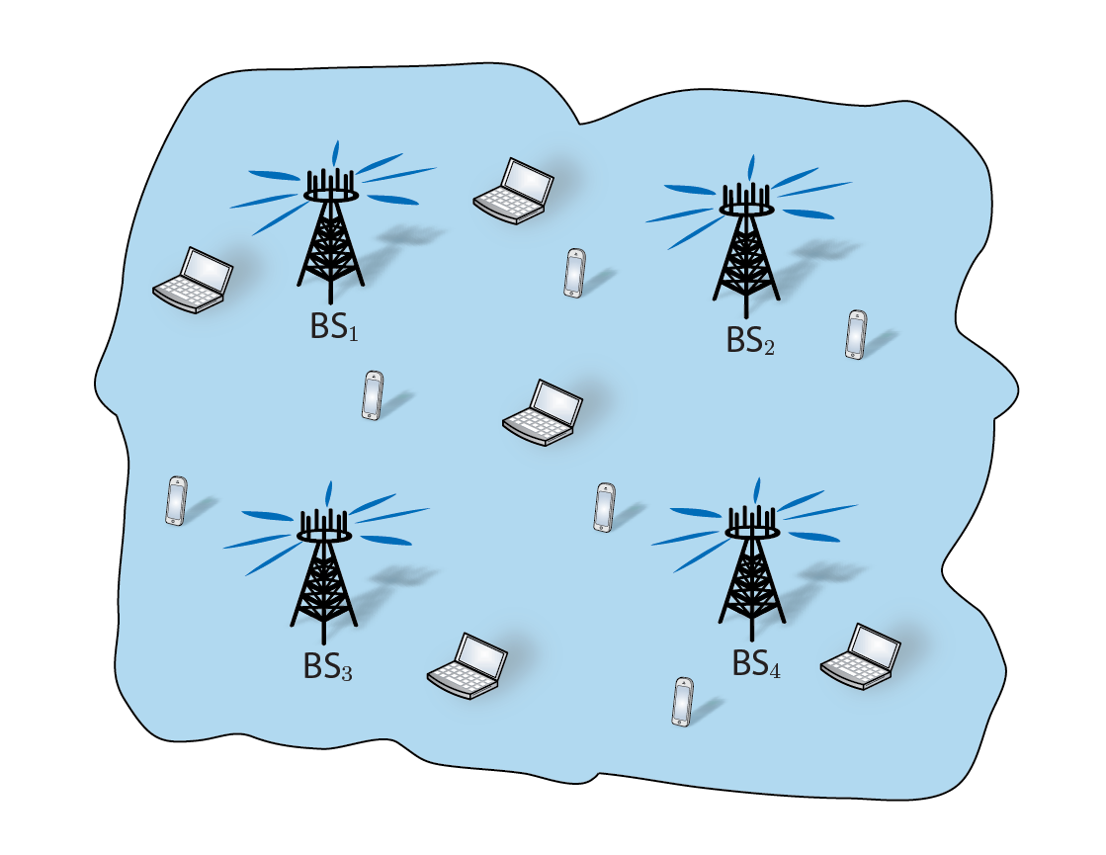
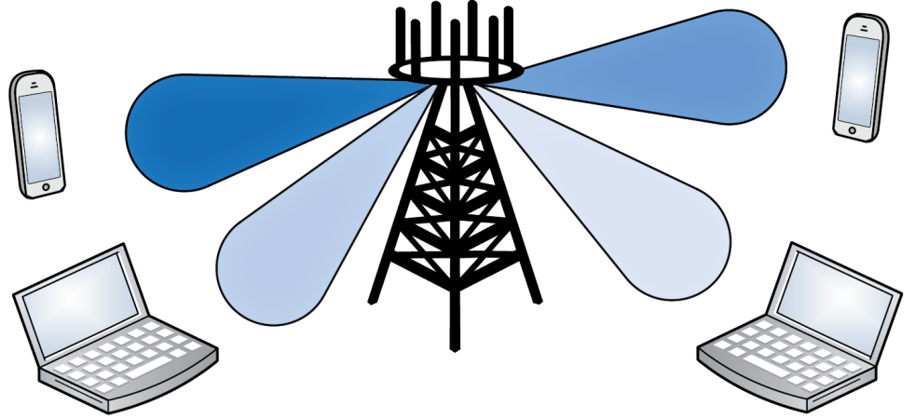
Introduction
Downlink Coordinated Multicell System
Many multi-antenna transmitters/BSs
Many single-antenna receivers
Sharing a Frequency Band
All signals reach everyone!
Limiting factor: co-user interference
Multi-Antenna Transmission
Spatially directed signals
Known as: Beamforming/precoding

Slide 3
Problem Formulation
Typical Problem Formulations:
Bad News: NP-hard problem (treating co-user interference as noise)
High complexity: Approximations are required in practice
Common approach: Propose an approx. and compare with old approxs.
Can we solve it optimally for benchmarking?
Weighted sum of user performance,
Proportional fairness,
etc.
maximize System Utility
Precoding for all users
subject to Power Constraints
(1)
Limited total power,
Limited power per transmitter,
Limited power per antenna
Z.-Q. Luo and S. Zhang, “Dynamic spectrum management: Complexity and duality,” IEEE Journal of Sel. Topics in Signal Processing, 2008.

Slide 4
Contribution & Timeliness
Main Contribution
Propose an algorithm to solve Problem (1) optimally
Timely: Several concurrent works
Differences from Concurrent Works
Use state-of-the-art branch-reduce-and-bound (BRB) algorithm
Handle robustness to channel uncertainty
Arbitrary multicell scenarios and performance measures
W. Utschick and J. Brehmer, “Monotonic optimization framework for coordinated beamforming in multicell networks,” IEEE Trans. on Signal Processing, vol. 60, no. 4, pp. 1899–1909, 2012.
L. Liu, R. Zhang, and K. Chua, “Achieving global optimality for weighted sum rate maximization in the K-user Gaussian interference channel with multiple antennas,” IEEE Trans. on Wireless Communications, vol. 11, no. 5, pp. 1933–1945, 2012.
BRB Algorithm: H. Tuy, F. Al-Khayyal, and P. Thach, “Monotonic optimization: Branch and cut methods,”, Springer, 2005.

Slide 5
System Model

Slide 6
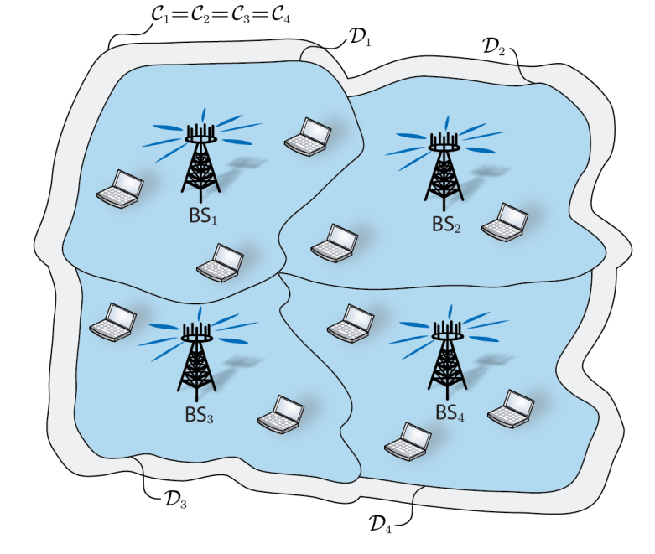
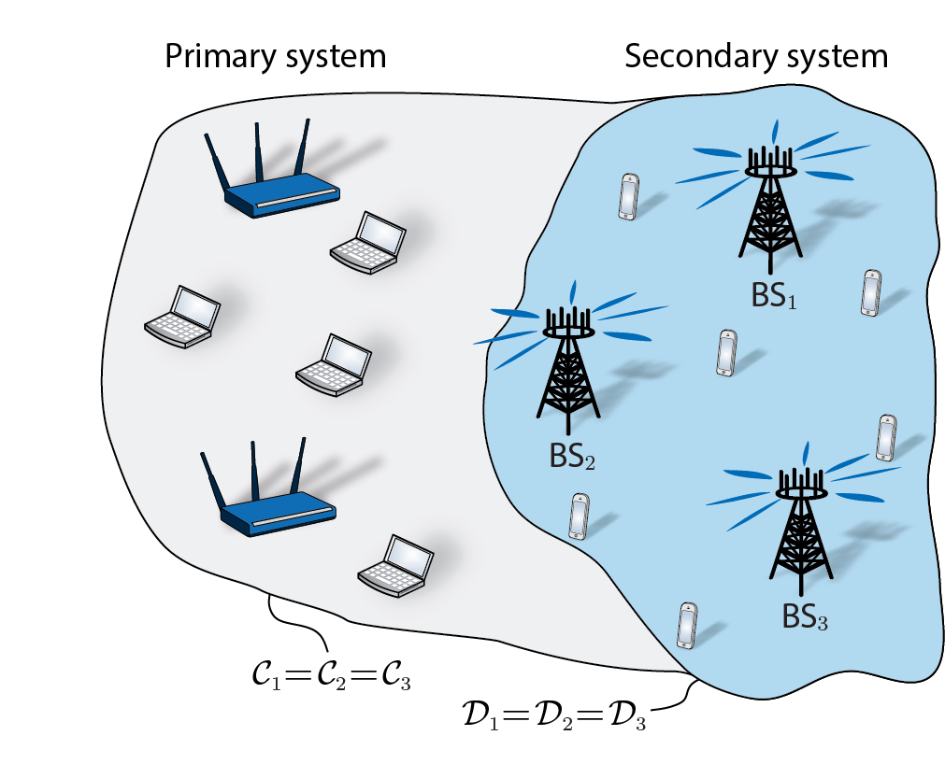
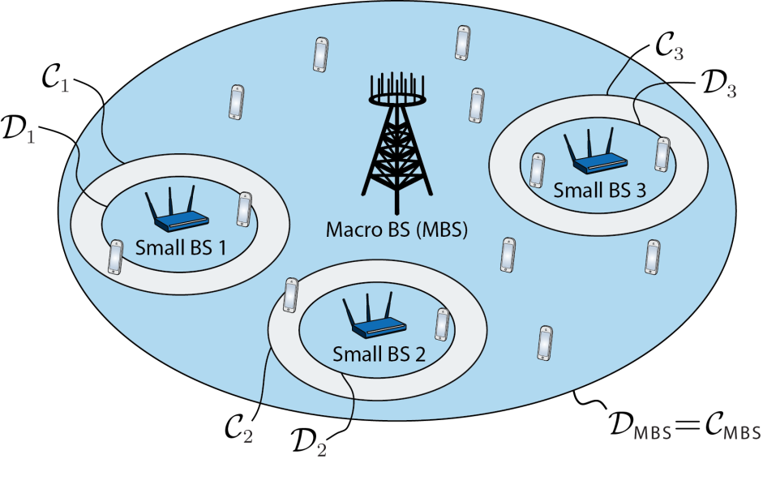
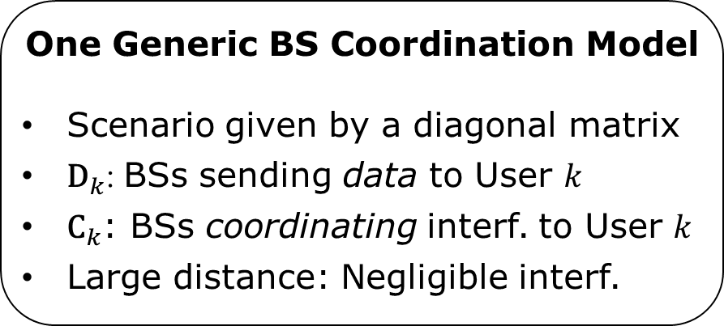
Many Different Multicell Scenarios
Ideal Joint Transmission
Coordinated Beamforming
(Interference channel)
Underlay Cognitive Radio
One Generic BS Coordination Model
Scenario given by a diagonal matrix
${\text{D}}_{k}$: BSs sending data to User $k$
${\text{C}}_{k}$: BSs coordinating interf. to User 𝑘
Large distance: Negligible interf.
Multi-Tier Coordination

Slide 7
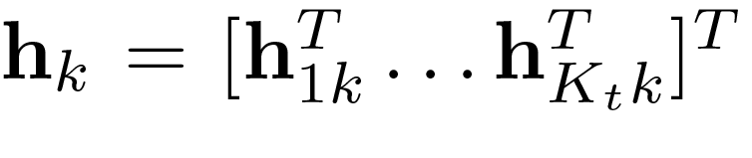
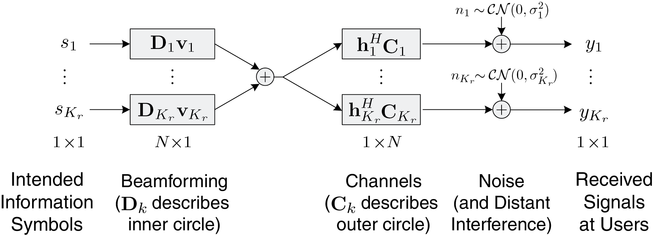
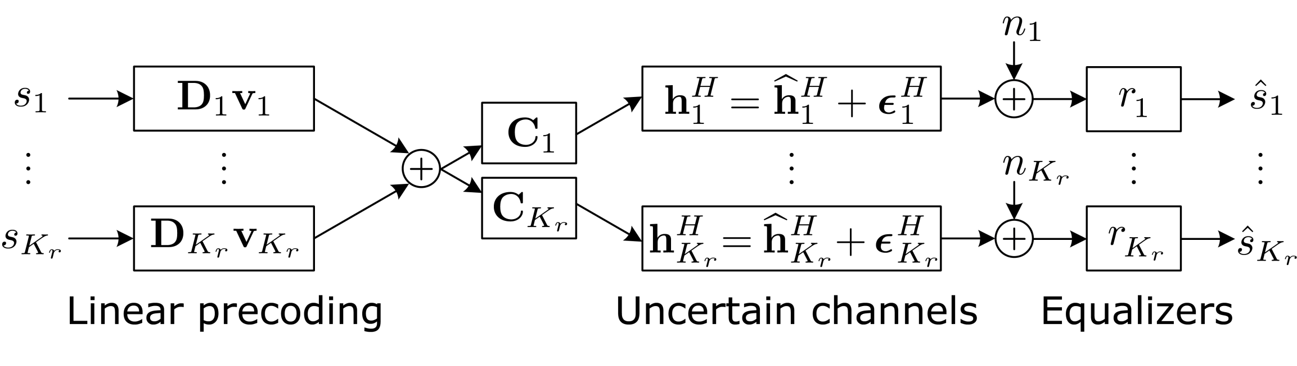
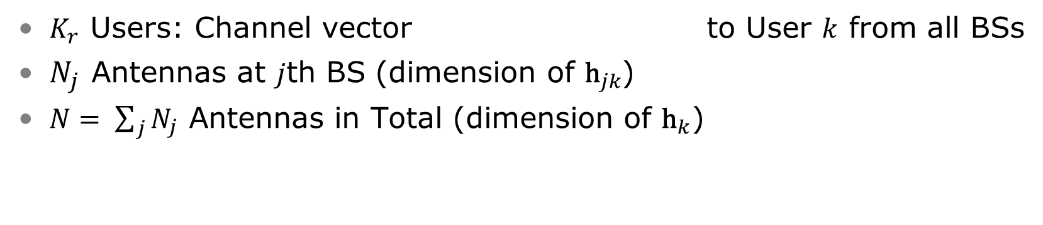
Multicell System Model
$K_{r}$ Users: Channel vector to User $k$ from all BSs
$N_{j}$ Antennas at $j$th BS (dimension of ${\text{h}}_{jk}$)
$N= \sum_{j}{N_{j}}$ Antennas in Total (dimension of ${\text{h}}_{k}$)

Slide 8
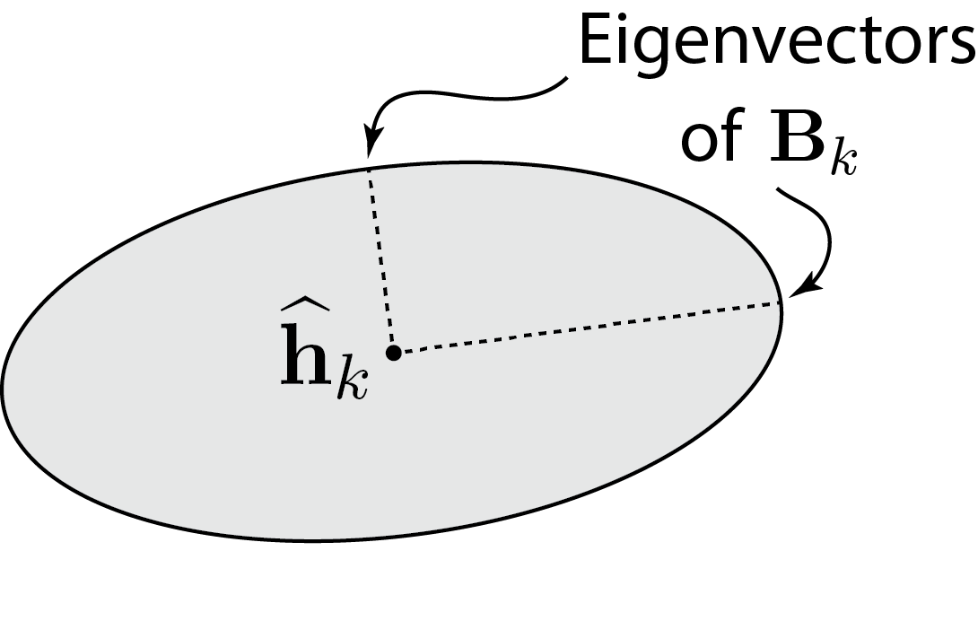
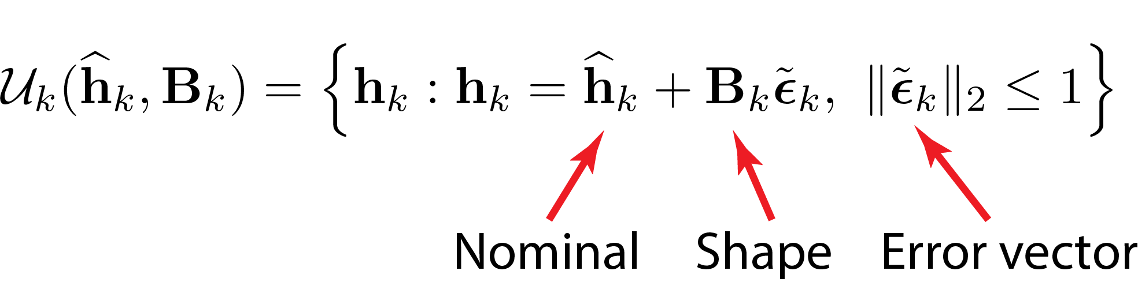
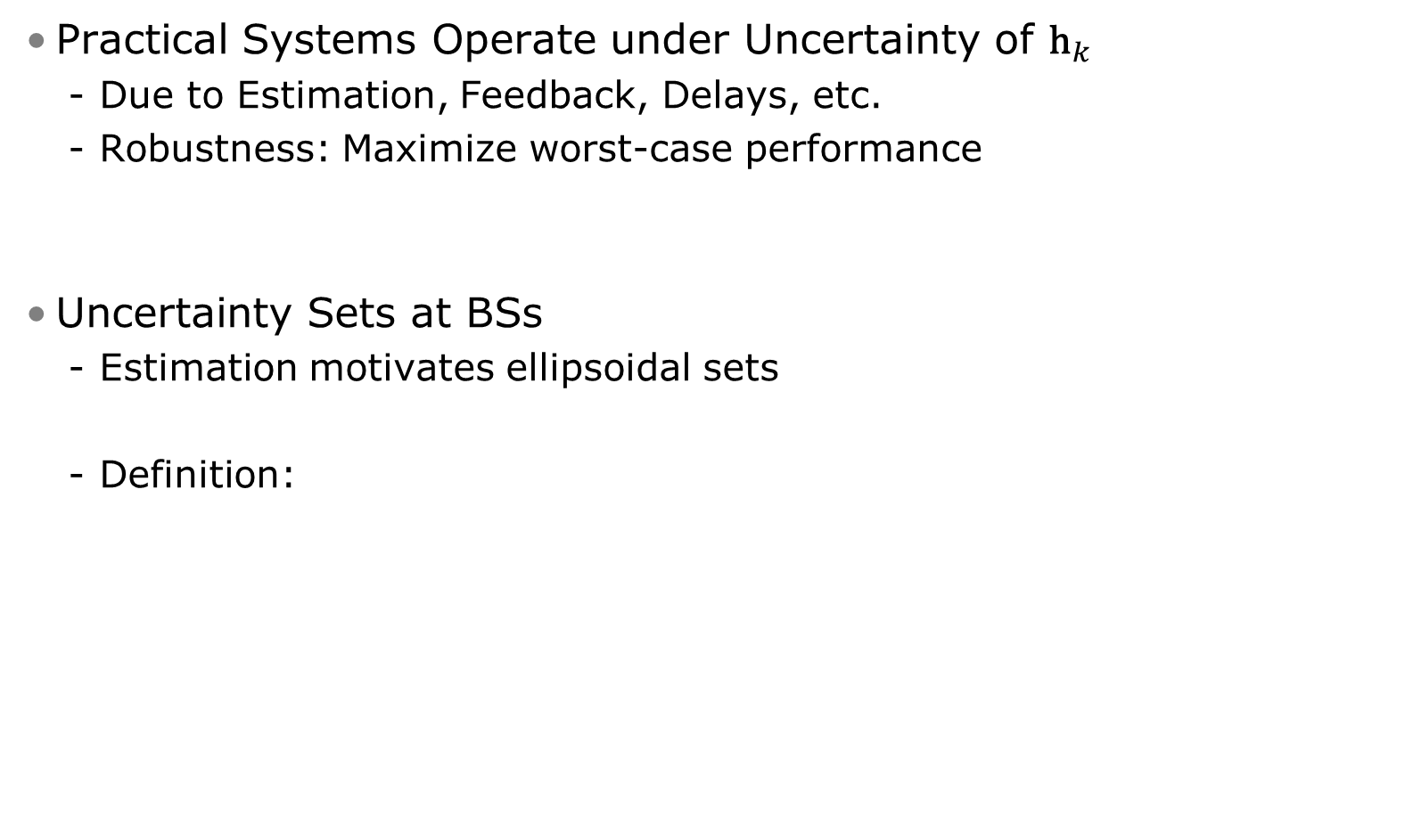
Robustness to Uncertain Channels
Practical Systems Operate under Uncertainty of ${\text{h}}_{k}$
Due to Estimation, Feedback, Delays, etc.
Robustness: Maximize worst-case performance
Uncertainty Sets at BSs
Estimation motivates ellipsoidal sets
Definition:

Slide 9
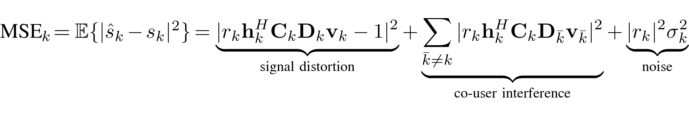

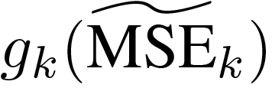
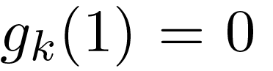
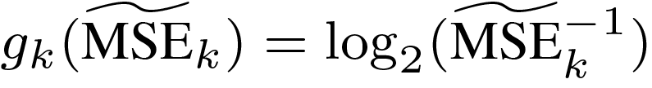
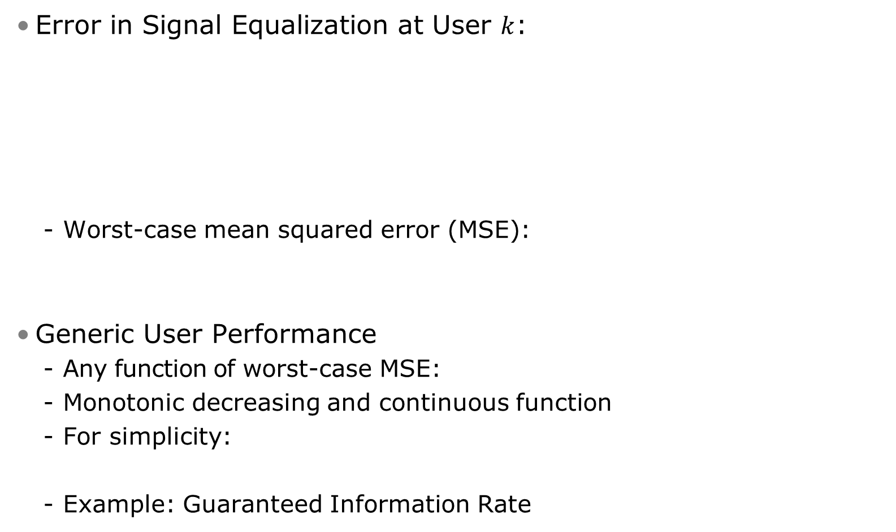
User Performance
Error in Signal Equalization at User $k$:
Worst-case mean squared error (MSE):
Generic User Performance
Any function of worst-case MSE:
Monotonic decreasing and continuous function
For simplicity:
Example: Guaranteed Information Rate

Slide 10
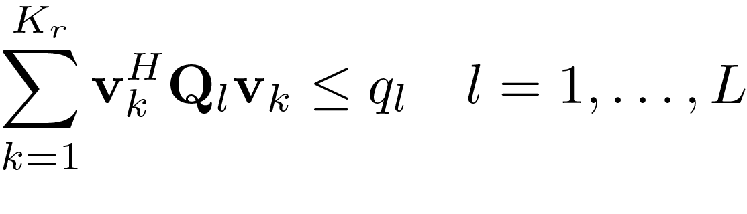
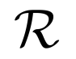
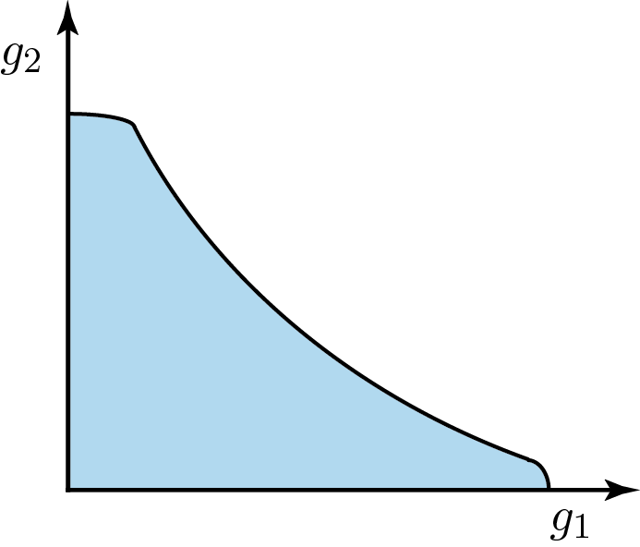
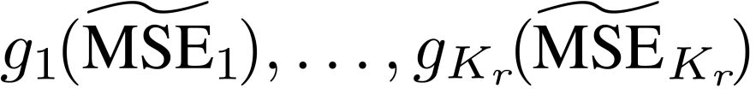
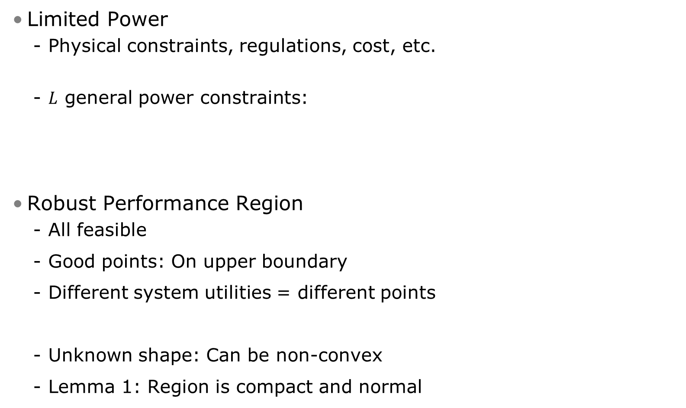
Robust Performance Region
Limited Power
Physical constraints, regulations, cost, etc.
$L$ general power constraints:
Robust Performance Region
All feasible
Good points: On upper boundary
Different system utilities = different points
Unknown shape: Can be non-convex
Lemma 1: Region is compact and normal
Limit
(Positive scalar)
Weighting matrix
(Positive semi-definite)
2-User
Performance Region

Slide 11
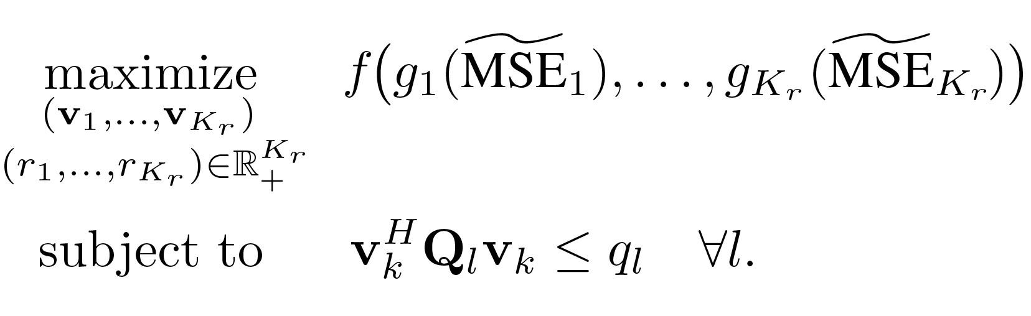
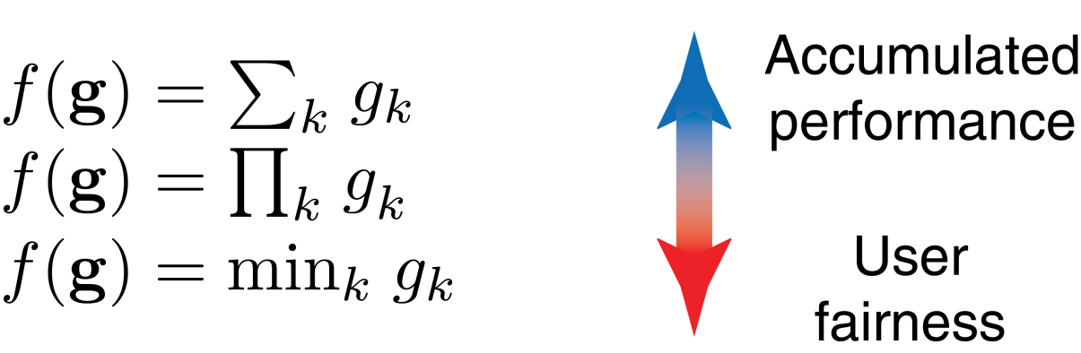
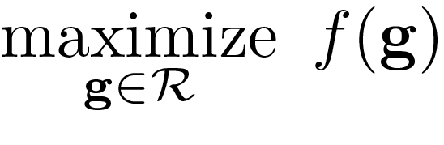
Problem Formulation
Find Optimal Solution to Detailed Version of (1):
For monotonic increasing system utility function :
Sum performance:
Proportional fairness:
Max-min fairness:
Equivalent to Search in Performance Region:
(2)

Slide 12
Special Case:
Fairness-Profile Optimization

Slide 13
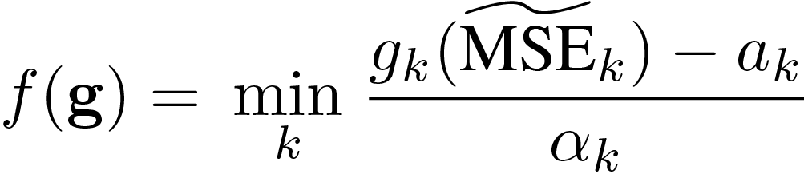
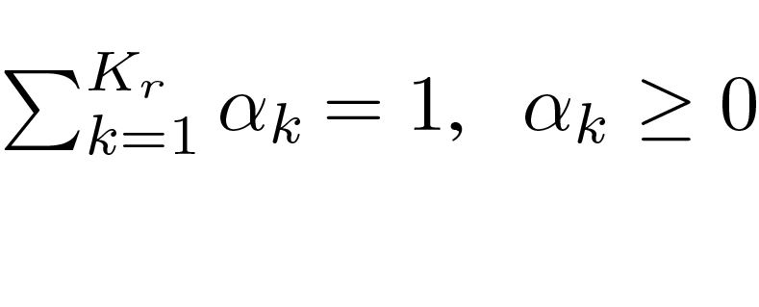
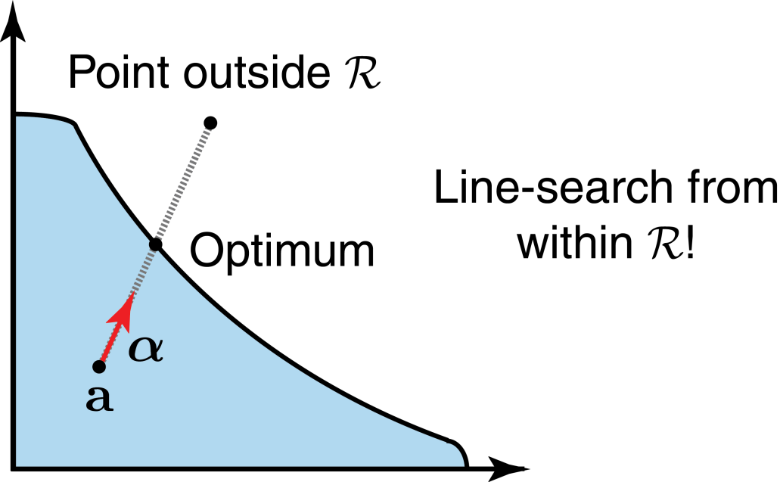
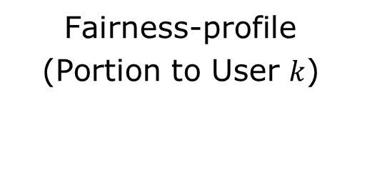
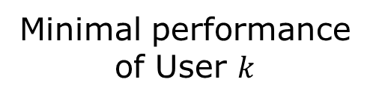
Fairness-Profile Optimization
Minimal performance of User $k$
Consider Special Case of (2):
Called: Fairness-profile optimization
Generalization of max-min fairness
Simple Geometric Interpretation
Can we search on the line?
Region is unknown
Fairness-profile
(Portion to User $k$)

Slide 14
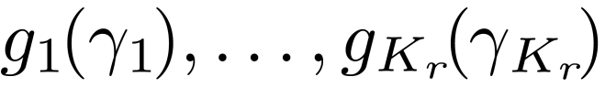
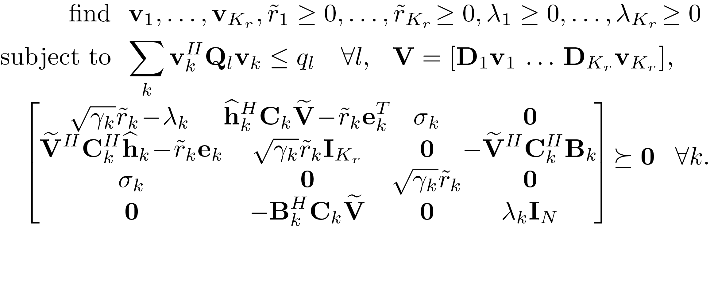
Fairness-Profile Optimization (2)
How to Check if a Point on the Line is Feasible?
Proof: Based on S-lemma in robust optimization
Theorem 1
A point is in the region if and only if the following convex feasibility problem is feasible:

Slide 15
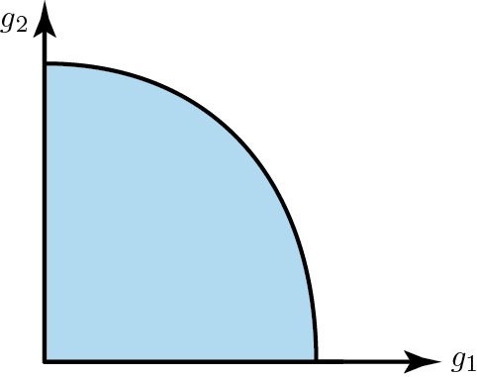
Fairness-Profile Optimization (3)
Simple Line-Search: Bisection
Line-search: Linear convergence
Sub-problem: Feasibility check
Works for any number of user
Bisection Algorithm
Find start interval
Check feasibility of midpoint using Theorem 1
If feasible:
Remove lower half
Else: Remove upper half
Iterate
Summary
Fairness-profile problem solvable in polynomial time!

Slide 16
BRB Algorithm

Slide 17
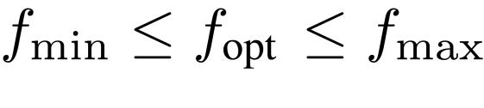
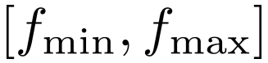
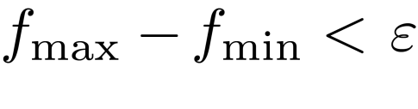
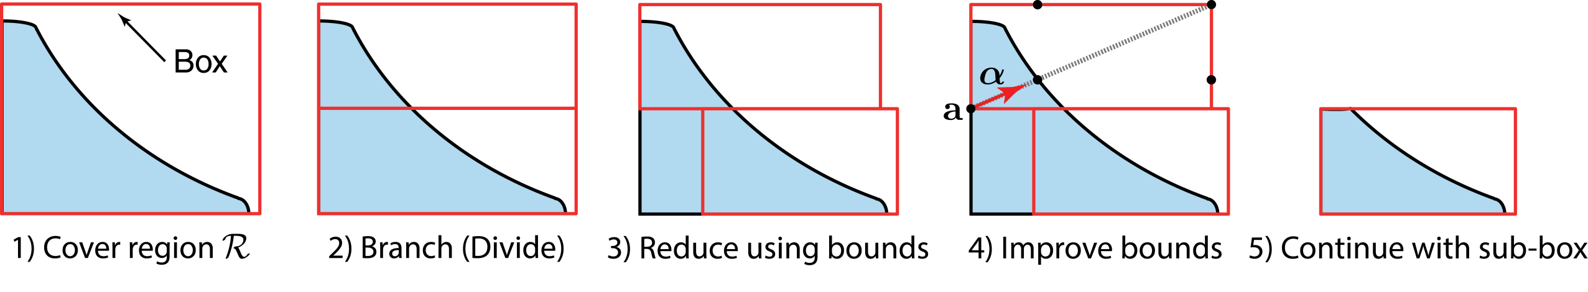
Computing Optimal Strategy: BRB Algorithm
Solve (2) for Any System Utility Function
Systematic search in performance region
Improve lower/upper bounds on optimum:
Branch-Reduce-and-Bound (BRB) Algorithm
Cover performance region with a box
Divide the box into two sub-boxes
Remove parts with no solutions in
Search for solutions to improve bounds
Continue with sub-box with largest value
End when bounds
are tight enough:
Accuracy

Slide 18
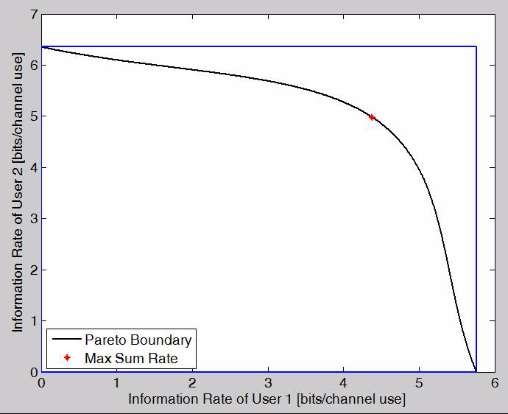
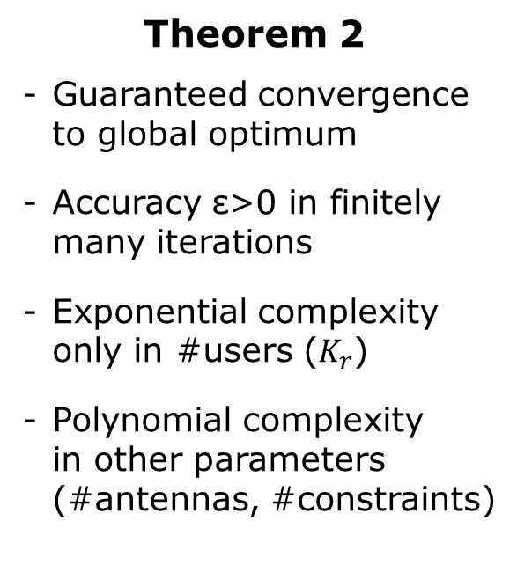
Computing Optimal Strategy: Example
Theorem 2
Guaranteed convergence to global optimum
Accuracy ε>0 in finitely many iterations
Exponential complexity only in #users ($K_{r}$)
Polynomial complexity in other parameters (#antennas, #constraints)

Slide 19
Numerical Examples

Slide 20
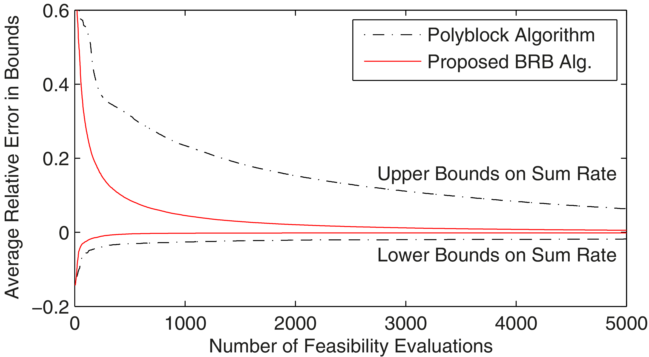
Example 1: Convergence
Convergence of Lower/Upper Bounds
Compared with Polyblock algorithm (proposed only for perfect CSI)
Scenario: 2 BSs, 3 antennas/BS, 2 users, perfect channel knowledge
Plot relative error in lower/upper bounds (sum rate optimization)
Observations
BRB algorithm has faster convergence
Lower bound converges rather quickly

Slide 21
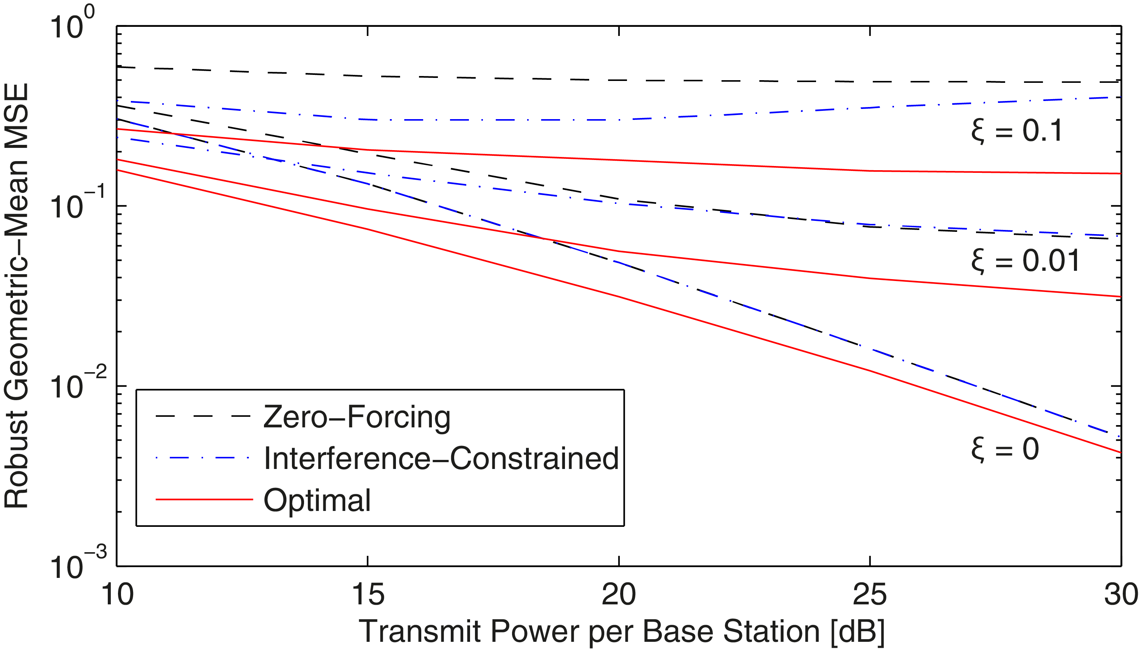
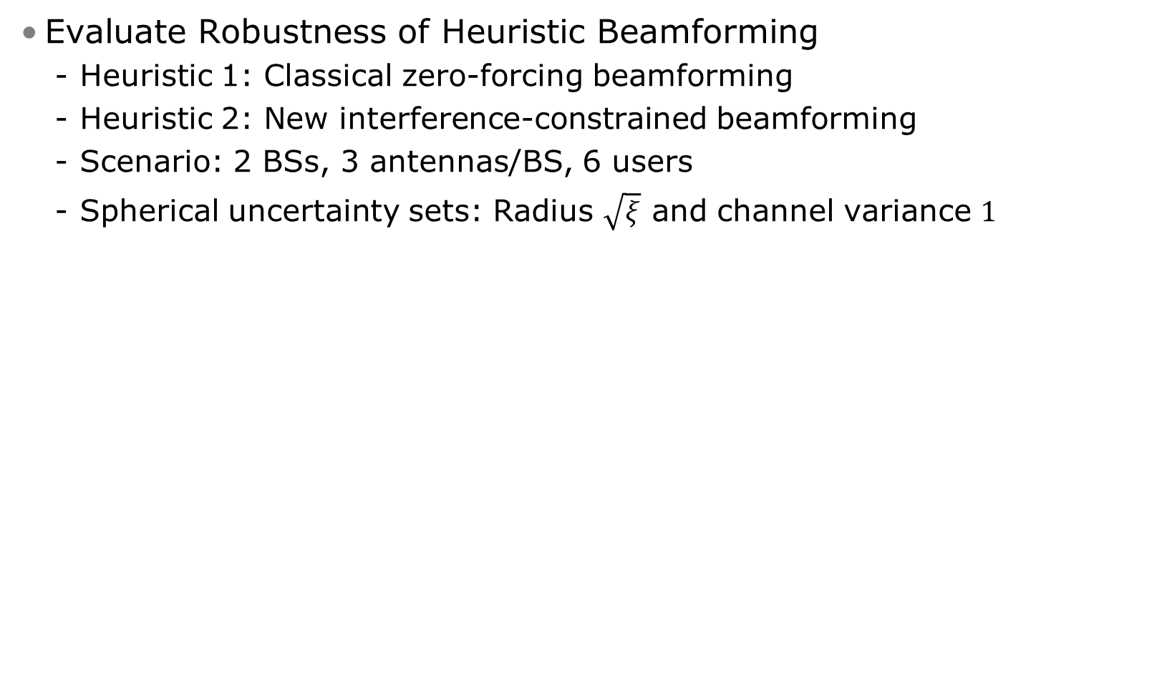
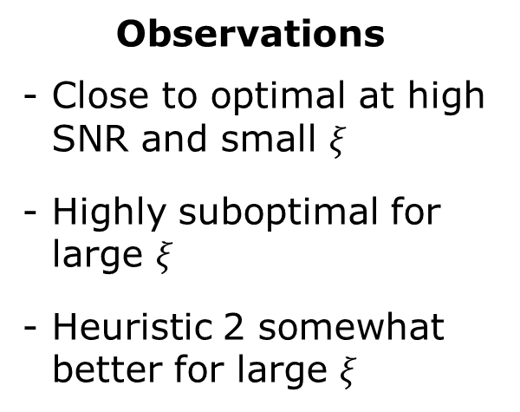
Example 2: Benchmarking
Evaluate Robustness of Heuristic Beamforming
Heuristic 1: Classical zero-forcing beamforming
Heuristic 2: New interference-constrained beamforming
Scenario: 2 BSs, 3 antennas/BS, 6 users
Spherical uncertainty sets: Radius $\sqrt{ξ}$ and channel variance $1$
Observations
Close to optimal at high SNR and small $ξ$
Highly suboptimal for large $ξ$
Heuristic 2 somewhat better for large $ξ$

Slide 22
Conclusion

Slide 23
Conclusion
Maximize System Utility in Coordinated Multicell Systems
NP-hard problem in general: Only suboptimal solutions in practice
How can we truly evaluate a suboptimal solution?
Robust Monotonic Optimization Framework
Solves a wide range of system utility maximizations
Handles channel uncertainty and any monotone performance measures
Subproblem: Fairness-profile optimization (FPO) = polynomial time
BRB algorithm: Solves finite number of FPO problems
Generalization: Problems where feasibility of a point is checked easily
Do you want to test it?
Download Matlab code from the book “Optimal Resource Allocation in Coordinated Multi-Cell Systems” by E. Björnson & E. Jorswieck
Based on CVX package by Steven Boyd et al.

Slide 24
Thank you for your attention!
Questions?

Slide 25
Backup Slides

Slide 26
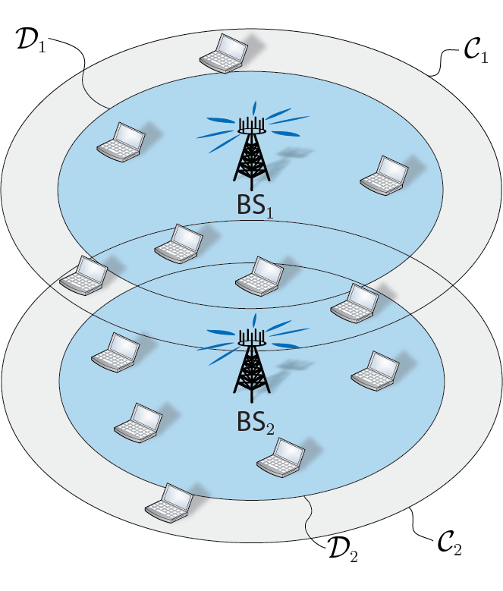


Generic Multicell Setup
Many examples:
Interference channel
Arbitrary overlapping cooperation clusters
Global joint transmission
Underlay cognitive radio, etc.
Dynamic Cooperation Clusters
Inner Circle : Serve users with data
Outer Circle : Suppress interference
Outside Circles:
Negligible impact – modeled as noise
26

Slide 27
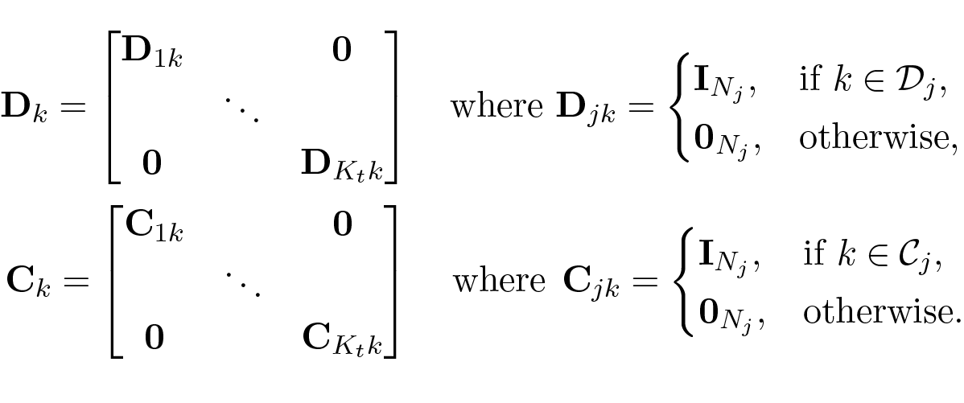
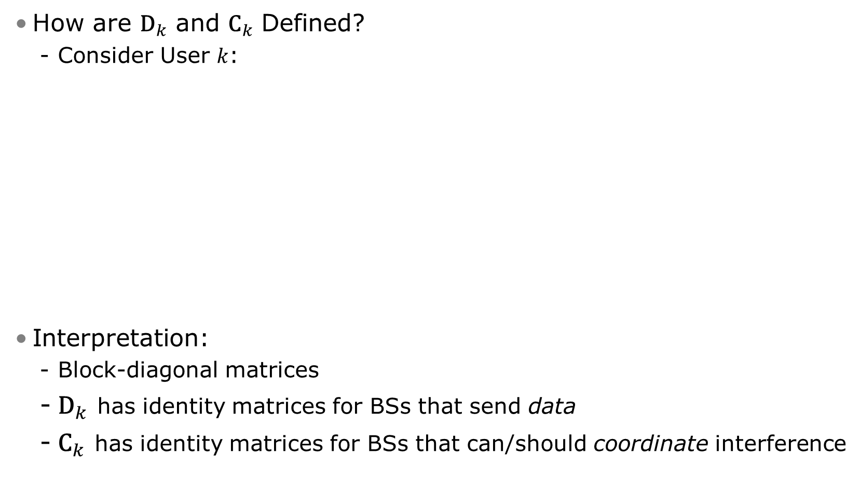
Dynamic Cooperation Clusters
How are ${\text{D}}_{k}$ and ${\text{C}}_{k}$ Defined?
Consider User $k$:
Interpretation:
Block-diagonal matrices
${\text{D}}_{k}$ has identity matrices for BSs that send data
${\text{C}}_{k}$ has identity matrices for BSs that can/should coordinate interference

Slide 28
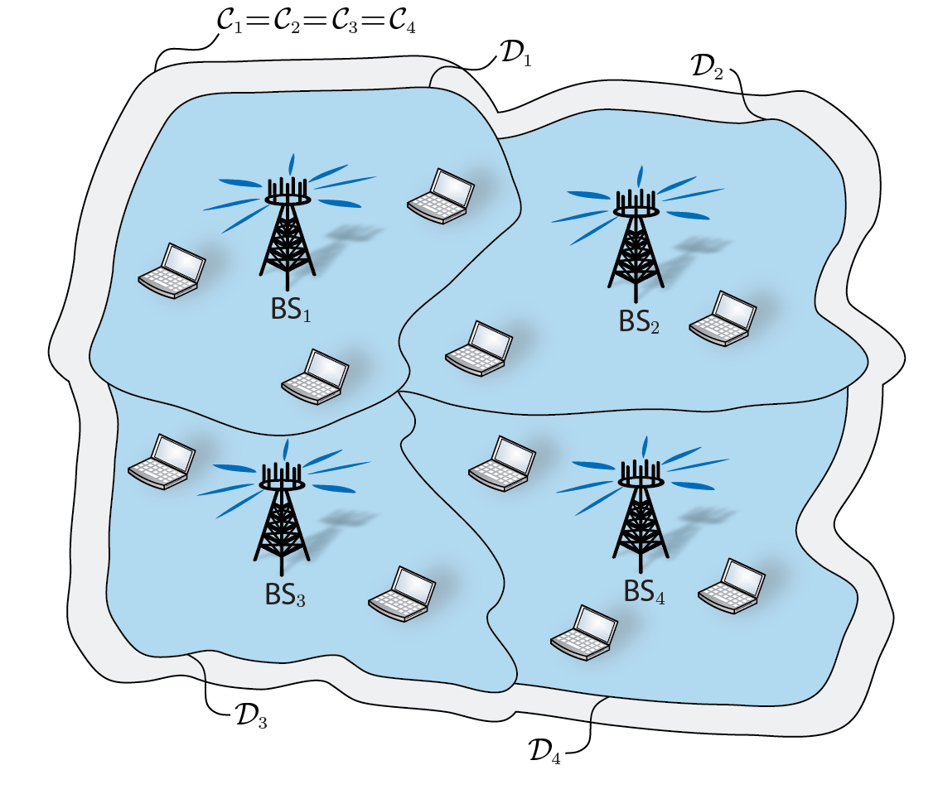
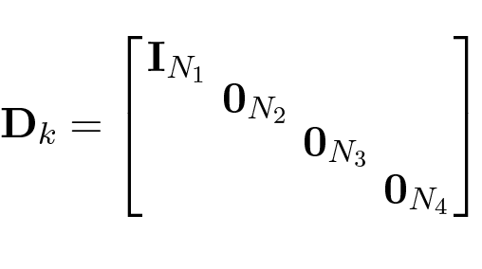
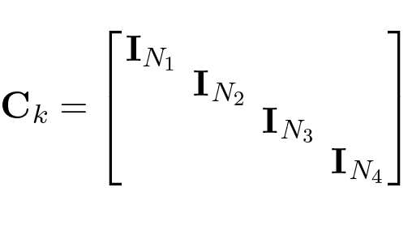

Dynamic Cooperation Clusters (2)
Example: Coordinated Beamforming
This is User $k$
Beamforming: ${\text{D}}_{k}{\text{v}}_{k}$ Data only from BS_{1:}
Effective channel: ${\text{C}}_{k}{\text{h}}_{k}$ Interference from all BSs:

Slide 29




Power Constraints: Examples
Recall:
Example 1, Total Power Constraint:
Example 2, Per-Antenna Constraints:
Example 3, Control Interference to User $i$

Slide 30

Performance Region: Shapes
Can the region have any shape?
No! Can prove that:
Compact set
Normal set
Upper corner in region, everything inside region

Slide 31

Performance Region: Shapes (2)
Some Possible Shapes
User-Coupling
Weak: Convex
Strong: Concave

